Slide 1
Presentation Outline
Abstract
Introduction
Literature Survey
Problem Statement
Objectives
Software Requirements
Hardware Requirements
Methodology
Application Snapshots
Conclusion
References

Slide 2
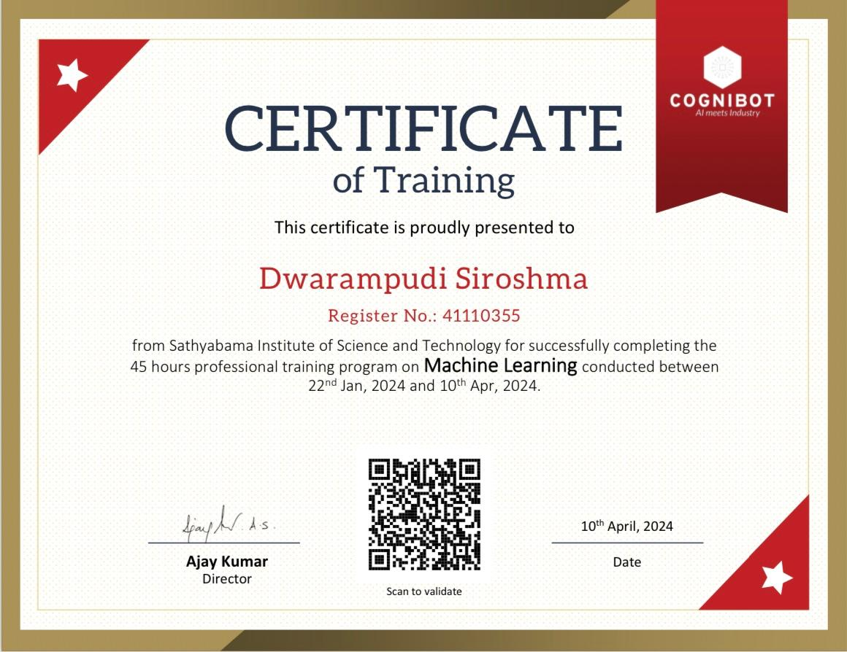
COURSE CERTIFICATE

Slide 3
Abstract
In IT companies, the human resource is the driving factor of the company's growth which depends on employees' motivation, skills and quality of work. Now-days the competitive advantage of most companies on global market lies in the ability to create a profit driven not only by cost efficiency, but by the ideas and intellectual know-how. So most organizations and companies are seeking talented, knowledgeable and experienced candidates for their job openings. Employee Satisfaction is a measure of workers contentedness with their job. Different factors may cause a change in the level of employee satisfaction. Every industry has different business environment, different policies for employment and different compensation measures. The goal of this project is to propose a employee satisfaction model to predict the measure of whether employees are satisfied or not. Naive bayes algorithm will be used for predictive model generation. Using this model, the factors affecting the employee satisfaction index will be identified and the company will provide handholding, care and support to the employees.

Slide 4
Introduction
Human resource is the most important factor for the success of any organization. Due to the technological advancements and complex lifestyles of the modern people, current job market shows rapid changes. With these drastic changes, employees are migrating to demanding jobs to discover their passion and to satisfy their life expectations. Job satisfaction is an important aspect due to the fact that it represents an overall summary of how an individual feel about a lifetime of work.

Slide 5
LITERATURE SURVEY
A review of literature on the analytic approach of employee satisfaction index using Naive Bayes classification reveals its effectiveness in predicting and understanding satisfaction levels. Johnson et al. (2018) demonstrated Naive Bayes' accuracy in categorizing satisfaction based on factors like job role, salary, work-life balance, and organizational culture.
Gupta and Singh (2019) conducted a comparative analysis, concluding Naive Bayes as adept at handling categorical variables and offering interpretable results. Additionally, Liu et al. (2020) applied Naive Bayes sentiment analysis to explore factors influencing satisfaction, providing actionable insights for organizational improvement.
Sharma and Verma (2017) focused on predicting attrition and satisfaction, showcasing Naive Bayes' utility in identifying risk factors. Wang et al. (2019) proposed a model integrating text mining with Naive Bayes, highlighting the importance of qualitative data in predicting satisfaction comprehensively.
These studies collectively underscore Naive Bayes' applicability across diverse organizational contexts, emphasizing the need to consider specific organizational nuances and challenges.
Naive Bayes emerges as a promising tool for analyzing employee satisfaction, as evidenced by several studies. Johnson et al. (2018) showcased its accuracy in categorizing satisfaction levels, while Gupta and Singh (2019) highlighted its strengths in handling categorical variables and providing interpretable results. The use of Naive Bayes sentiment analysis by Liu et al.(2020) revealed actionable insights for improving organizational satisfaction.
Moreover, Sharma and Verma (2017) demonstrated Naive Bayes' utility in predicting attrition risk, complementing studies like Wang et al. (2019), which integrated text mining techniques for comprehensive satisfaction analysis.
These findings collectively advocate for the adoption of Naive Bayes in analyzing employee satisfaction, with an acknowledgment of the importance of addressing organizational nuances

Slide 6
Problem Statement
In contemporary organizations, ensuring high levels of employee satisfaction is paramount for productivity, retention, and overall organizational success. However, measuring and understanding employee satisfaction can be complex due to diverse factors and subjective perceptions involved. To address this challenge, this study aims to develop an analytic approach using the Naive Bayes algorithm to assess and predict employee satisfaction levels based on various input variables.

Slide 7
Objectives
Data Collection: Gather comprehensive datasets comprising employee demographics, job roles, tenure, performance metrics, and satisfaction feedback.
Feature Selection: Identify relevant features that significantly influence employee satisfaction levels.
Data Preprocessing: Cleanse, normalize, and preprocess the collected data to ensure quality and consistency.
Model Training: Implement the Naive Bayes algorithm to train a predictive model using the preprocessed data.
Model Evaluation: Assess the performance of the trained model through cross-validation and other relevant metrics to ensure accuracy and reliability.
Predictive Analysis: Utilize the trained model to predict employee satisfaction levels based on new data inputs.
Interpretation and Recommendations: Analyze the model results to gain insights into the factors influencing employee satisfaction and provide actionable recommendations for organizational improvement.

Slide 8
Software Requirements
Operating System : Windows, Mac, Linux
Language : R Programming : R-4.1.3
GUI : RStudio

Slide 9
Hardware Requirements
Hardware Requirements:
Processor :Processor Intel CORE i3 and above
RAM : 4 GB
Internet Connection : Existing telephone lines, Data card, Fiber net

Slide 10
Methodology
Identify stakeholders and gather functional and non-functional requirements.
Define the database schema, user interface, access control logic, and data validation.
Implement user authentication, CRUD functionalities, role-based access control, and data validation.
Develop intuitive user interfaces using HTML, CSS, and JavaScript.
Integrate frontend and backend components, perform unit and integration testing, and conduct user acceptance testing.
Implement robust authentication mechanisms, input validation, HTTPS, and regular updates.
Deploy the system, monitor performance, provide user support, and regularly update with new features and security patches.

Slide 11
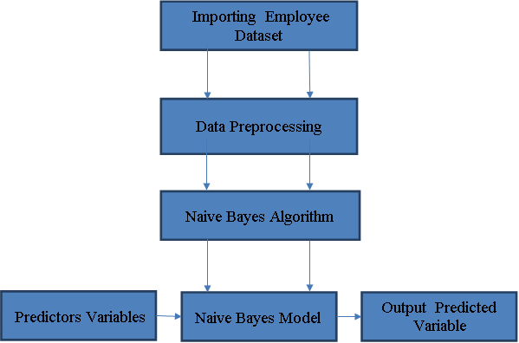
Architectural Diagram

Slide 12
Project Modules
There are four Modules
Importing Employee dataset
Data Preprocessing
Model Generation Using Naive Bayes Algorithm
Prediction using Naive Bayes Model

Slide 13
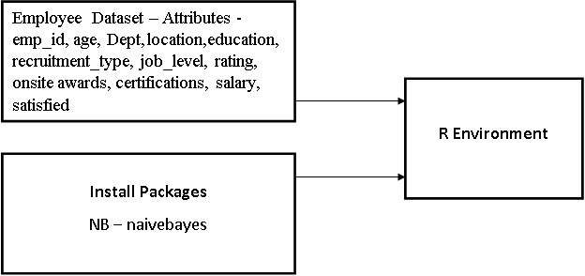
Importing Employee Dataset
Data have to be imported in to R environment for analysis.
Data can be any format like txt, .csv, .xlsx, .SPSS etc.
Package necessary for Naive Bayes algorithm have to be installed and loaded in to the program. NB – naivebayes

Slide 14
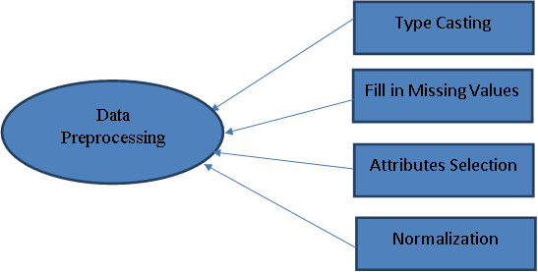
Data Preprocessing
In Data Preprocessing, it is not necessary to hold all the attributes for doing the analysis, we can hold only the attributes which is affecting the analysis.

Slide 15
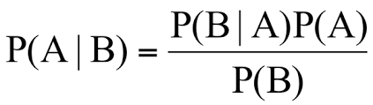
Model Generation Using Navie Bayes Algorithm
Naive Bayes is a classification and prediction algorithm based on Bayes Theorem.
Bayes Theorem
P(A|B) - Probability of occurrence of event A given the event B is true - Posterior Probability
P(A) - Probabilities of the occurrence of event A - Class prior Probability
P(B) - Probabilities of the occurrence of event B – Predictor Prior Probability
P(B|A) - Probability of the occurrence of event B given the event A is true - Likelihood

Slide 16
Model Generation Using Navie Bayes Algorithm
Step 1: Convert the data set into a frequency table
Step 2: Create Likelihood table by finding the probabilities values of each attributes
Step 3: Now, use Naive Bayesian equation to calculate the posterior probability for each class. The class with the highest posterior probability is the outcome of prediction.
Steps in Naive Bayes algorithm

Slide 17
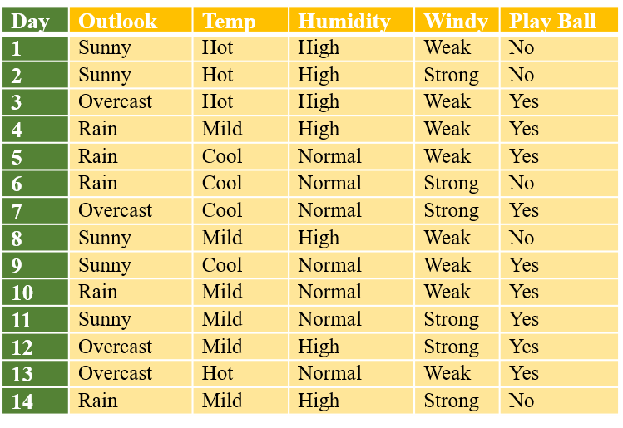
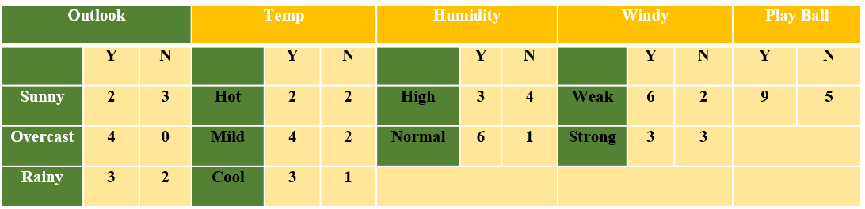
Model Generation Using Navie Bayes Algorithm
P(S,C,H,S) = P(S)*P(C)*P(H)*P(S)
= 5/14 * 4/14 *7/14*6/14
= 0.0216
Likelihood for Yes = 2/9 * 3/9 * 3/9* 3/9
= 0.0082
Likelihood for No = 3/5 * 1/5 * 4/5* 3/5
= 0.0576
Posterior Probability of Yes = (0.0082*
9/14) / 0.0216 =0.245
Posterior Probability of No = (0.0576 *
5/14) / 0.0216 =0.952
The posterior probability for the No is higher, so the probability of no is higher.
Bayes Theorem
Sunny, Cool, High, Strong
P(Yes |S,C,H,S) = P(S,C,H,S | Yes) *P(Yes)
/ P(S,C,H,S)
P(No | S,C,H,S) = P(S,C,H,S | No) *P(No)
/ P(S,C,H,S)

Slide 18

Prediction Using Navie Bayes Model
Once Naive Bayes model have been created,
By using testing data, model can be evaluated
By giving only predictor variables, target variable can be predicted

Slide 19
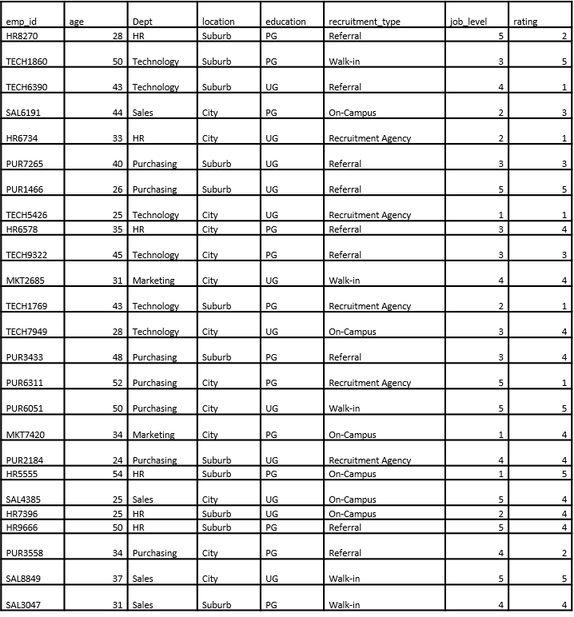
Navie Bayes Model
Sample Data Sets

Slide 20
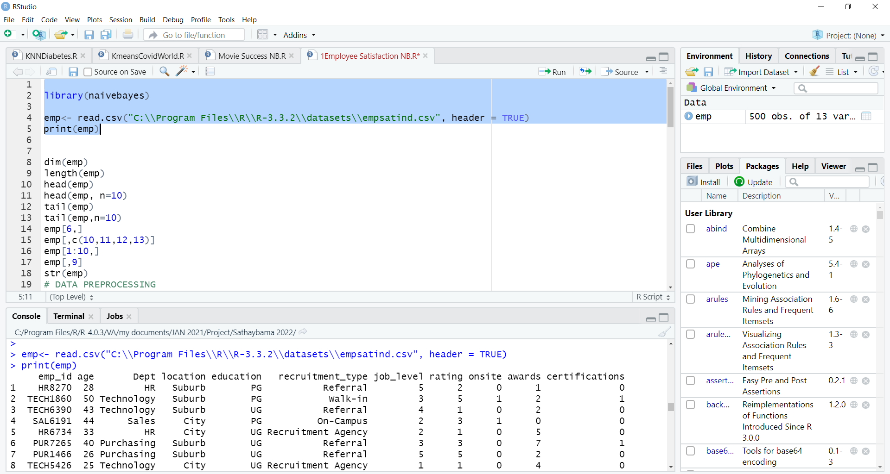
Navie Bayes Model
Data Importing

Slide 21
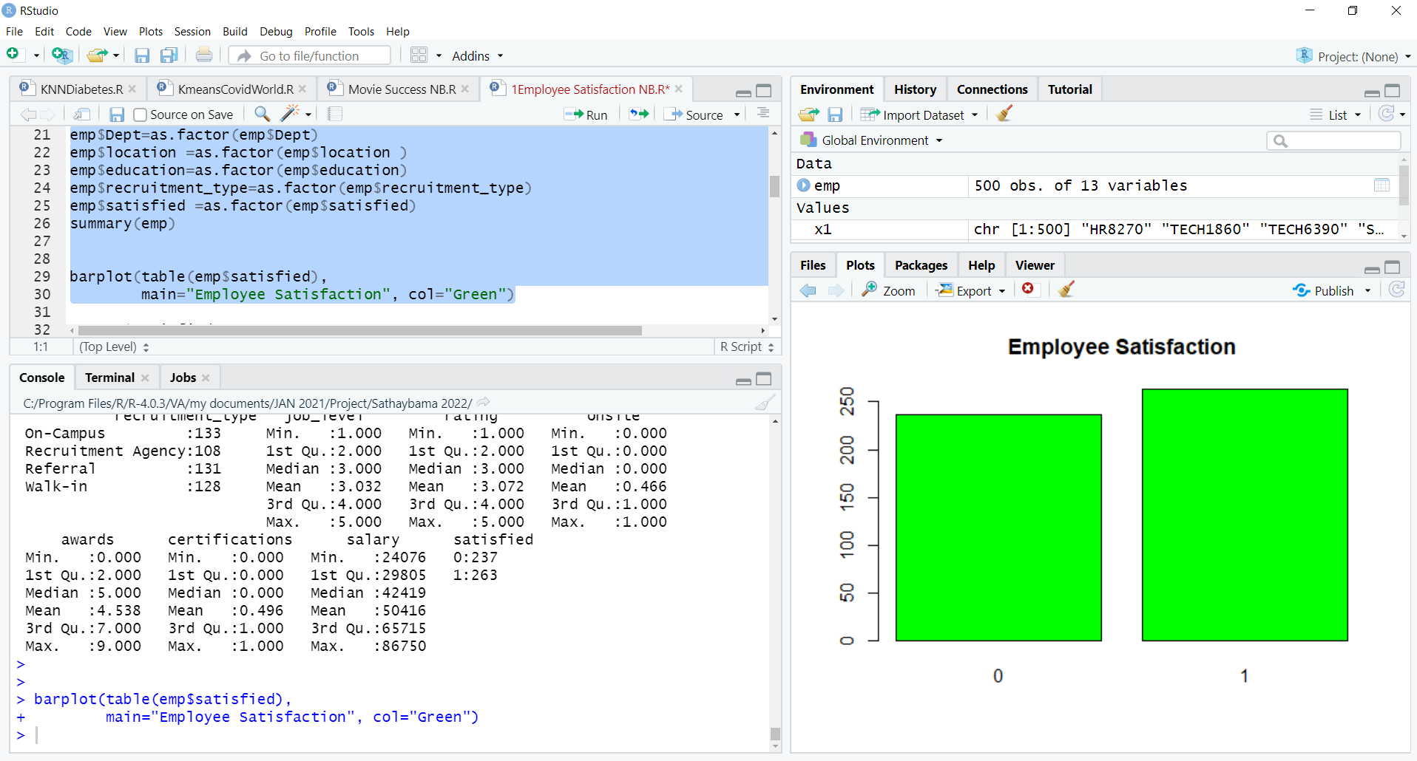
Navie Bayes Model
Data Preprocessing

Slide 22
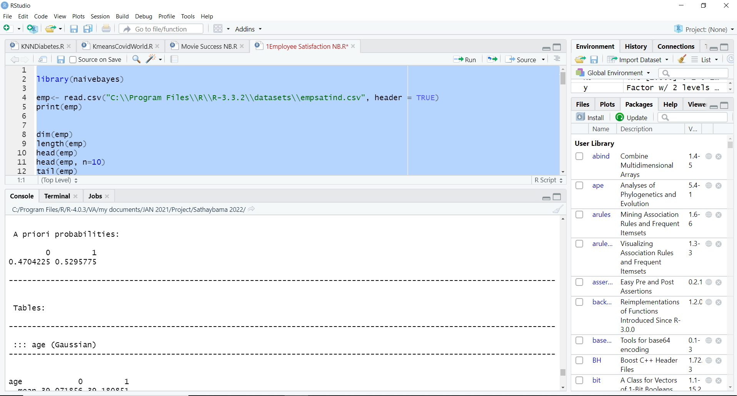
Navie Bayes Model
Naive Bayes Classification Model

Slide 23
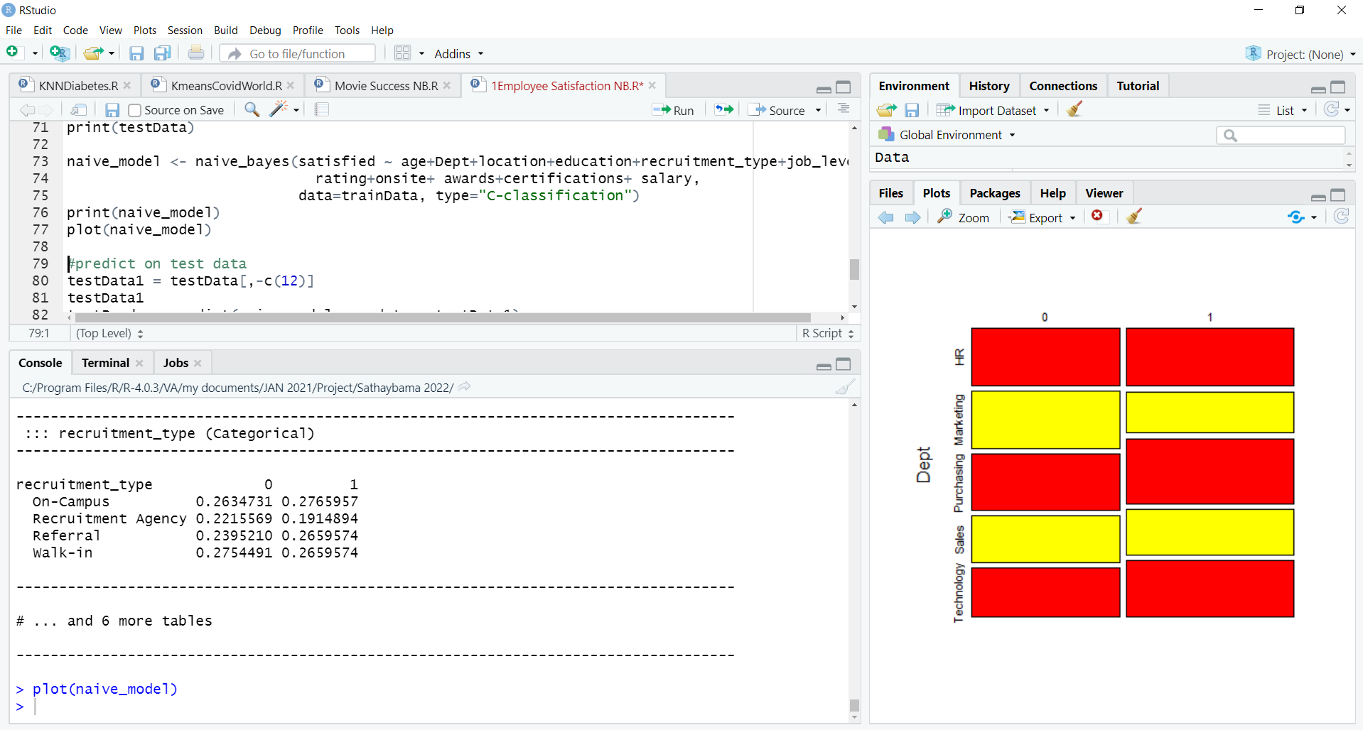
Navie Bayes Model
Naive Bayes Classification Model

Slide 24
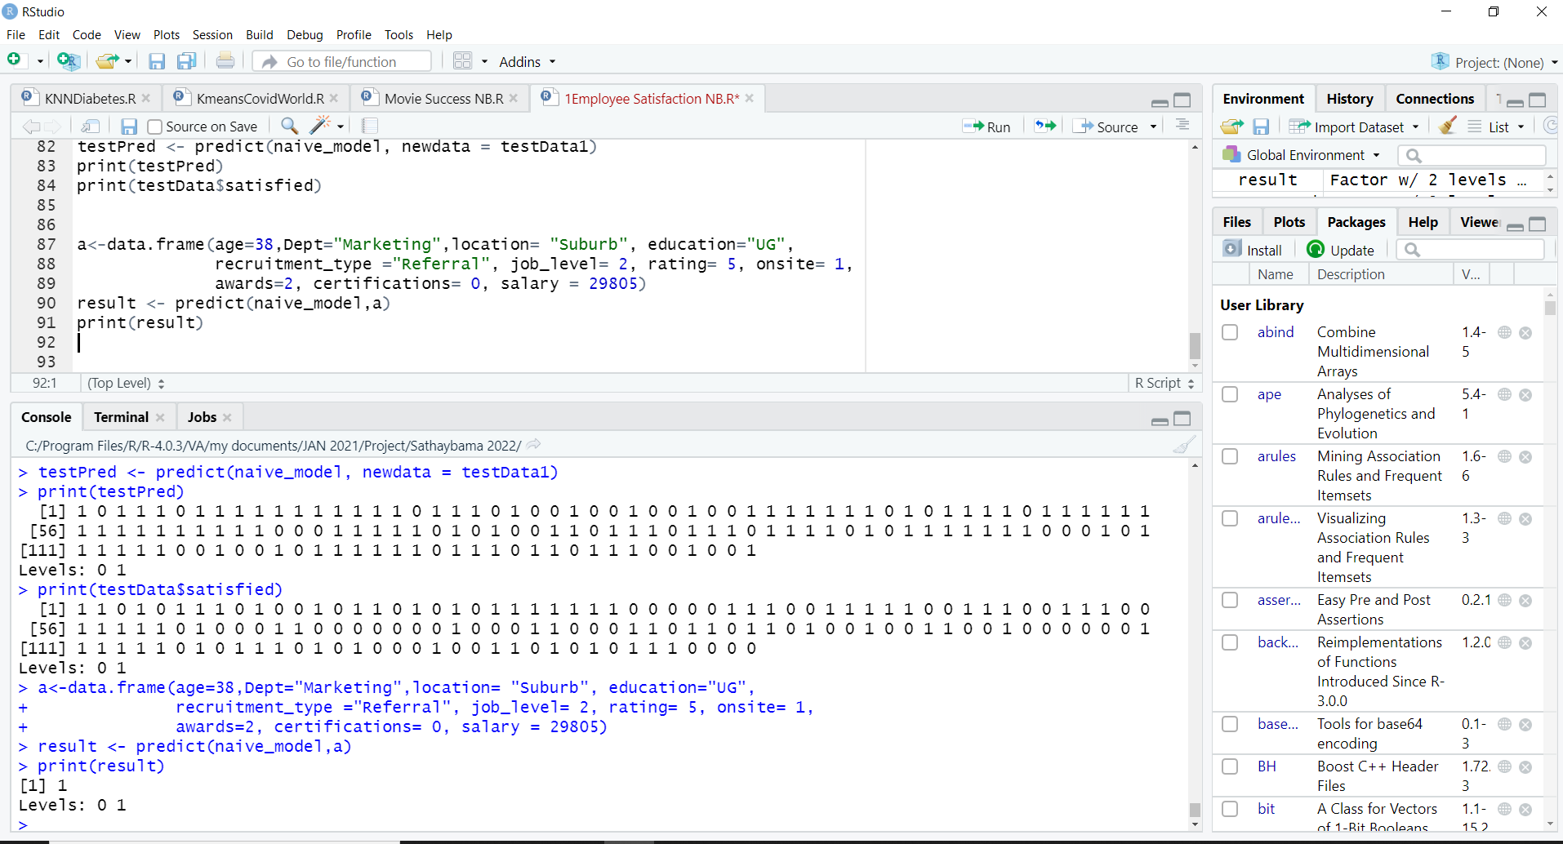
Navie Bayes Predictive Model

Slide 25
Conclusion
Job satisfaction is defined as a pleasurable or positive emotional state from the appraisal of one's job or experiences. This project presents a recommendation system that uses Data Science algorithm for predicting, the job satisfaction of employees in the company. The Naive Bayes Data Science algorithm is used for predicting whether the employee is having job satisfaction or not. Thus, this project concludes, Naive Bayes Algorithm performs better and faster when compared to other statistical techniques. This project can be further extended using some more data science algorithm and deep learning algorithms to improve the performance of prediction system. Foreseeing the employees' job satisfaction makes it easy for a company to take swift actions to improve the job satisfaction of its employees.

Slide 26
Reference
1. A. McCallum and K. Nigam, "A Comparison of Event Models for Naive Bayes Text Classification," in Proceedings of the AAAI-98 Workshop on Learning for Text Categorization, 1998.
2. J. Rennie, L. Shih, J. Teevan, and D. Karger, "Tackling the Poor Assumptions of Naive Bayes Text Classifiers," in Proceedings of the 20th International Conference on Machine Learning (ICML-2003), 2003.
3. S. Rennie, "Improving Multi-Class Text Classification with Naive Bayes," in Proceedings of the 22nd International Conference on Machine Learning (ICML-2005), 2005.
4. S. Thrun, "Naive Bayes for Text Classification with Unbalanced Classes," in Proceedings of the 14th European Conference on Machine Learning (ECML-2003), 2003.
5. K. Nigam, A. McCallum, S. Thrun, and T. Mitchell, "Text Classification from Labeled and Unlabeled Documents using EM," Machine Learning, vol. 39, no. 2-3, pp. 103-134, 2000.
6. P. Domingos and M. Pazzani, "Beyond Independence: Conditions for the Optimality of the Simple Bayesian Classifier," in Proceedings of the 13th International Conference on Machine Learning (ICML-1996), 1996.
7. C. D. Manning, P. Raghavan, and H. Schütze, Introduction to Information Retrieval. Cambridge University Press, 2008. [Chapter 13: Naive Bayes and Text Classification]
8. D. Jurafsky and J. H. Martin, Speech and Language Processing, 3rd ed. Pearson, 2020. [Chapter 4: Naive Bayes and Sentiment Classification]
9. T. Hastie, R. Tibshirani, and J. Friedman, The Elements of Statistical Learning: Data Mining, Inference, and Prediction. Springer, 2009. [Chapter 6: Naive Bayes Methods]
10. Y. Freund and R. E. Schapire, "A Decision-Theoretic Generalization of On-Line Learning and an Application to Boosting," Journal of Computer and System Sciences, vol. 55, no. 1, pp. 119-139, 1997..

